Slide 1
Handwriting Recognition using OCR - Optical Character Recognition
Done By:
Kruthi Tatavarthy

Slide 2
Contents
What is OCR?
Advantages of Handwriting Recognition using OCR
Disadvantages of Handwriting Recognition using OCR
Problem Statement
Deep Learning Techniques used to overcome the challenges
Conclusion

Slide 3
What is OCR?
OCR - Optical Character Recognition, sometimes known as text recognition is a process in which data is extracted and reused from scanned documents, camera photos, and image-only PDFs by an OCR application.
The original material can be accessed and edited by using OCR software, which letters on the image, turns them into words, and then turns the words into sentences.

Slide 4
Advantages of Handwriting Recognition using OCR
Cost Cutting
Speed up workflows
Automate content processing and document routing
Data centralization and security (no fires, break-ins or documents lost in the back vaults)
Ensure staff members have access to the most recent and correct information to improve service

Slide 5
Disadvantages of Handwriting Recognition using OCR
Handwriting strokes vary from person to person
An individual's handwriting style also changes and fluctuates over time
Individuals do not have to write a line of text in a straight line on white paper like a text document
Character separation and identification in cursive writing are difficult, contrary to printed text

Slide 6
Problem Statement
Although handwriting recognition (Handwriting OCR) or handwritten text recognition (HTR) is a crucial part of optical character recognition, it is still regarded as a difficult problem statement. Converting handwritten text into machine readable text is extremely difficult due to the wide variation in handwriting styles across individuals and the inferior quality of handwritten text compared to printed text. However, it's an issue in several sectors, including banking, insurance, and healthcare, needed to be resolved.
Therefore, we will learn about the complexity of the task of handwritten text recognition in this project, as well as how deep learning techniques can be used to resolve it.

Slide 7
Deep Learning Techniques used to overcome the challenges
Handwriting recognition was first approached using machine learning techniques like Hidden Markov Models (HMM), SVM, etc. After the initial text is pre-processed, feature extraction is done to extract important details about a certain character, such as loops, inflection points, aspect ratio, etc. To obtain the results, these created features are now sent to a classifier, such as an HMM. Due to their restricted learning ability and manual feature extraction phase, machine learning models perform very poorly.
In this project, I covered about some of the leading studies on deep learning for handwriting recognition. Multi-dimensional Recurrent Neural Networks such as RNN/LSTM and Connectionist Temporal Classification (CTC) are used in this project.

Slide 8
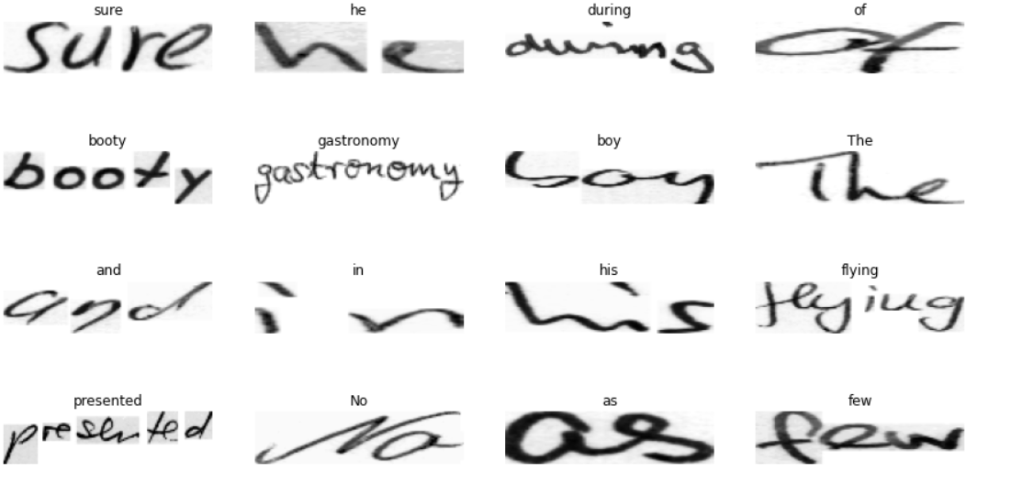
If we just go with plain resizing the images would look like so:

Slide 9
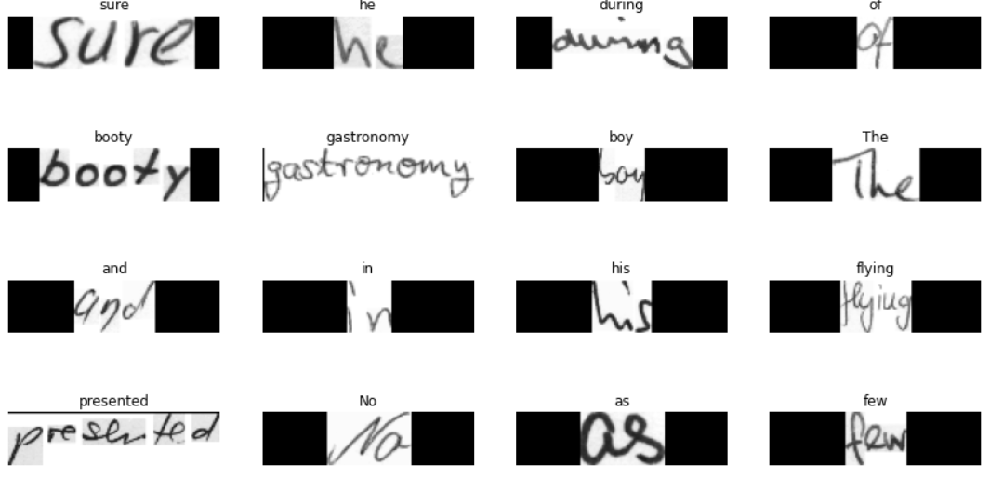
After visualizing few samples:

Slide 10
Conclusion
Although there have been major technological advancements that aid in better handwritten text recognition, handwriting recognition is still far from a solved problem when compared to OCR and is hence not yet widely used in industry. Nevertheless, given the speed at which technology is developing and the arrival of models like transformers, we may anticipate that handwriting recognition along with OCR models will soon become the norm.

Slide 11
Thank you

